Slide 1
Introduction
Devops and continuous delivery using Jenkins, kubernetes and docker

Slide 2



About the instructor
Omri Siri
Age 32
Tel-Aviv
Previously:
Director of operations @ Avantis - a startup in the AdTech industry
Lead DevOPS @ Liveperson
14+ years of Linux experience

Slide 3
Agenda
Introduction to DevOPS and continuous delivery
puppet in a nutshell
Git source code management
CI/CD with jenkins
Docker
kubernetes
Alternatives for Jenkins and git on AWS

Slide 4
Lets begin!

Slide 5
What is DevOps?
Culture ?
Collaboration of development and operation teams ?
Using automation tools ?
Using monitoring tools ?

Slide 6
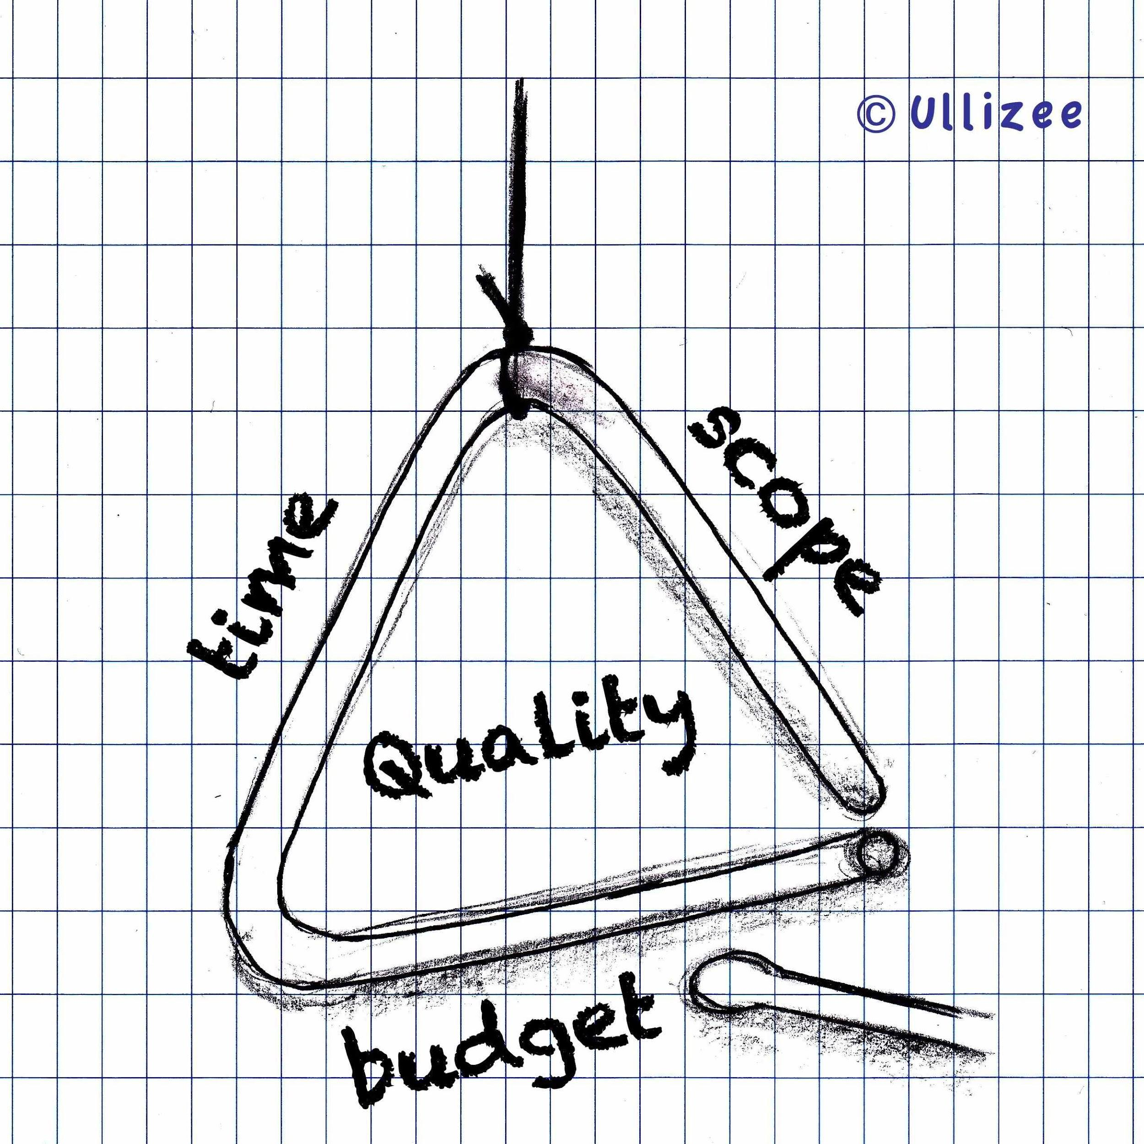
How do you measure software value?
Revenue - Cost of development - Cost of operations = Value
The iron triangle
Notes:
Requirment gathering (who gathers, who to talk)
Lojman
RapidInformer
StatusSiren

Slide 7
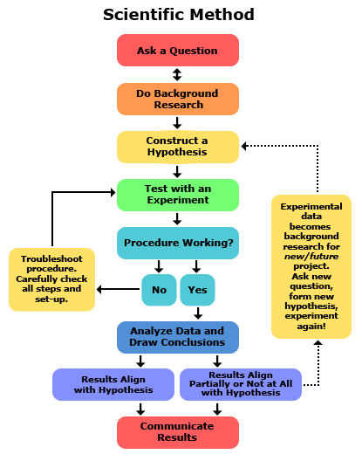
Scientific Method
Notes:
A scientific method is the whole set of techniques used to acquire new knowledge or to confirm or arrange an existing knowledge
The most important step is observing
The scientific method is in a cycle that is constantly developing more useful, more accurate, natural methods and comprehensive models

Slide 8
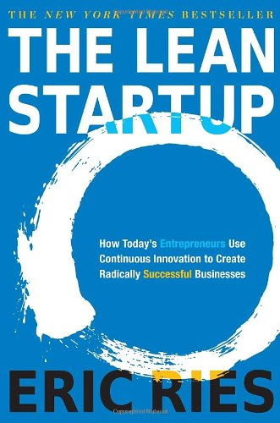
Lean Startup
Have a vision for your product, make the business model
Build the minimum viable product
Test and iterate
Pivot when you reach local maximum

Slide 9

Fast Feedback Loops
Delivery Pipeline
build
test
release
plan
monitor
Developers
Customers
Feedback Loop

Slide 10
Fast Feedback Loops
Delivery Pipeline
build
test
release
plan
monitor
Developers
Customers
Feedback Loop
DevOps is cultural, organizational, technological changes that speed up this lifecycle

Slide 11
What is wrong with Waterfall model?
Assumptions
There exists a reasonably well-defined set of requirements if we only take the time to understand them.
During the development process, changes to requirements will be small enough that we can manage them without substantially rethinking or revising our plans.
System integration is an appropriate and necessary process, and we can reasonably predict how it will go based upon architecture and planning.
Software innovation and the research and development that is required to create a significant new software application can be done on a predictable schedule.

Slide 12
What is wrong with Waterfall model?
The Real Life
The software systems that we craft are unlike the mechanical and physical devices of the past. Software is intangible.
The “Yes, But” syndrome. Customer does not know what he/she wants.
Changing business behavior. The approach of full requirements definition, followed by a long gap before those requirements are delivered is no longer appropriate.
Software integration and deployments take too much time. Happens at very late night or morning and involves multiple people.

Slide 13
Agile Manifesto
Our highest priority is to satisfy the customer through early and continuous delivery of valuable software.
Welcome changing requirements, even late in development. Agile processes harness change for the customer's competitive advantage.
Deliver working software frequently, from a couple of weeks to a couple of months, with a preference to the shorter timescale.
Business people and developers must work together daily throughout the project.
Working software is the primary measure of progress.
http://agilemanifesto.org/principles.html
Notes:
2001

Slide 14
Waterfall Organization
Business
Requirements
Design
Engineering
Coding and Unit Test
System Integration
Operations
Operations and Maintenance

Slide 15
Water - Scrum - Fall
Business
Requirements
Engineering
Analysis
Development
Scrum
Testing
Operations
System Integration
Operations and Maintenance

Slide 16
Continuous Integration
Continuous Integration is a software development practice where members of a team integrate their work frequently, usually each person integrates at least daily - leading to multiple integrations per day. Each integration is verified by an automated build (including test) to detect integration errors as quickly as possible. Many teams find that this approach leads to significantly reduced integration problems and allows a team to develop cohesive software more rapidly.
Martin Fowler

Slide 17
Continuous Integration
Practices
Maintain a single source repository
Automate the build
Make your build self-testing
Every commit should build on an integration machine
Keep the build fast
Test in a clone of the production environment
Make it easy for anyone to get the latest executable
Everyone can see what’s happening
Automate deployment
https://www.thoughtworks.com/continuous-integration

Slide 18
Continuous Integration
How to do it
Developers check out code into their private workspaces.
When done, commit the changes to the repository.
The CI server monitors the repository and checks out changes when they occur.
The CI server builds the system and runs unit and integration tests.
The CI server releases deployable artefacts for testing.
The CI server assigns a build label to the version of the code it just built.
The CI server informs the team of the successful build.
If the build or tests fail, the CI server alerts the team.
The team fix the issue at the earliest opportunity.
Continue to continually integrate and test throughout the project.
https://www.thoughtworks.com/continuous-integration

Slide 19
Continuous Integration
Team Responsibility
Check in frequently
Don’t check in broken code
Don’t check in untested code
Don’t check in when the build is broken
Don’t go home after checking in until the system builds
https://www.thoughtworks.com/continuous-integration

Slide 20
Continuous Delivery
Why ?
Low-risk releases
Faster time to market
Higher quality
Lower costs
Better products
Happier teams
https://continuousdelivery.com/

Slide 21
Continuous Delivery
Principles
Build quality
Work in small batches
Computers perform repetitive tasks, people solve problems
Relentlessly pursue of continuous improvement
Everyone is responsible
https://continuousdelivery.com/

Slide 22
Continuous Delivery / Configuration Management
Goals
Reproducibility
Traceability
Benefits
Disaster Recovery
Auditability
Higher Quality
Capacity Management
Response to Defects
https://continuousdelivery.com/

Slide 23
Hotfix Process
Load Balancer
us-west-2b
us-west-2c
Web
version 1
Web
version 1
Web
version 1
Web
version 1
Engine
version 1
Engine
version 1
Engine
version 1
Engine
version 1
Redis
DynamoDB

Slide 24
Hotfix Process
Load Balancer
us-west-2b
us-west-2c
Web
version 1
Web
version 2
Web
version 2
Web
version 1
Engine
version 2
Engine
version 1
Engine
version 1
Engine
version 2
Redis
DynamoDB

Slide 25
Hotfix Process
Load Balancer
us-west-2b
us-west-2c
Web
version 2
Web
version 2
Web
version 2
Web
version 2
Engine
version 2
Engine
version 2
Engine
version 2
Engine
version 2
Redis
DynamoDB

Slide 26
Monitoring
System Monitoring
Application Performance Monitoring
Web Monitoring
Mobile Monitoring
Error Detection
Log Detection

Slide 27
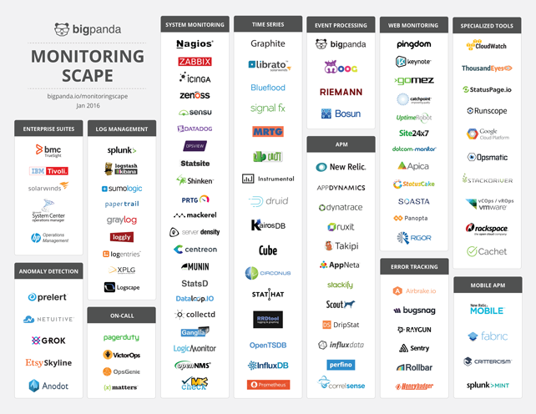
Monitoring

Slide 28
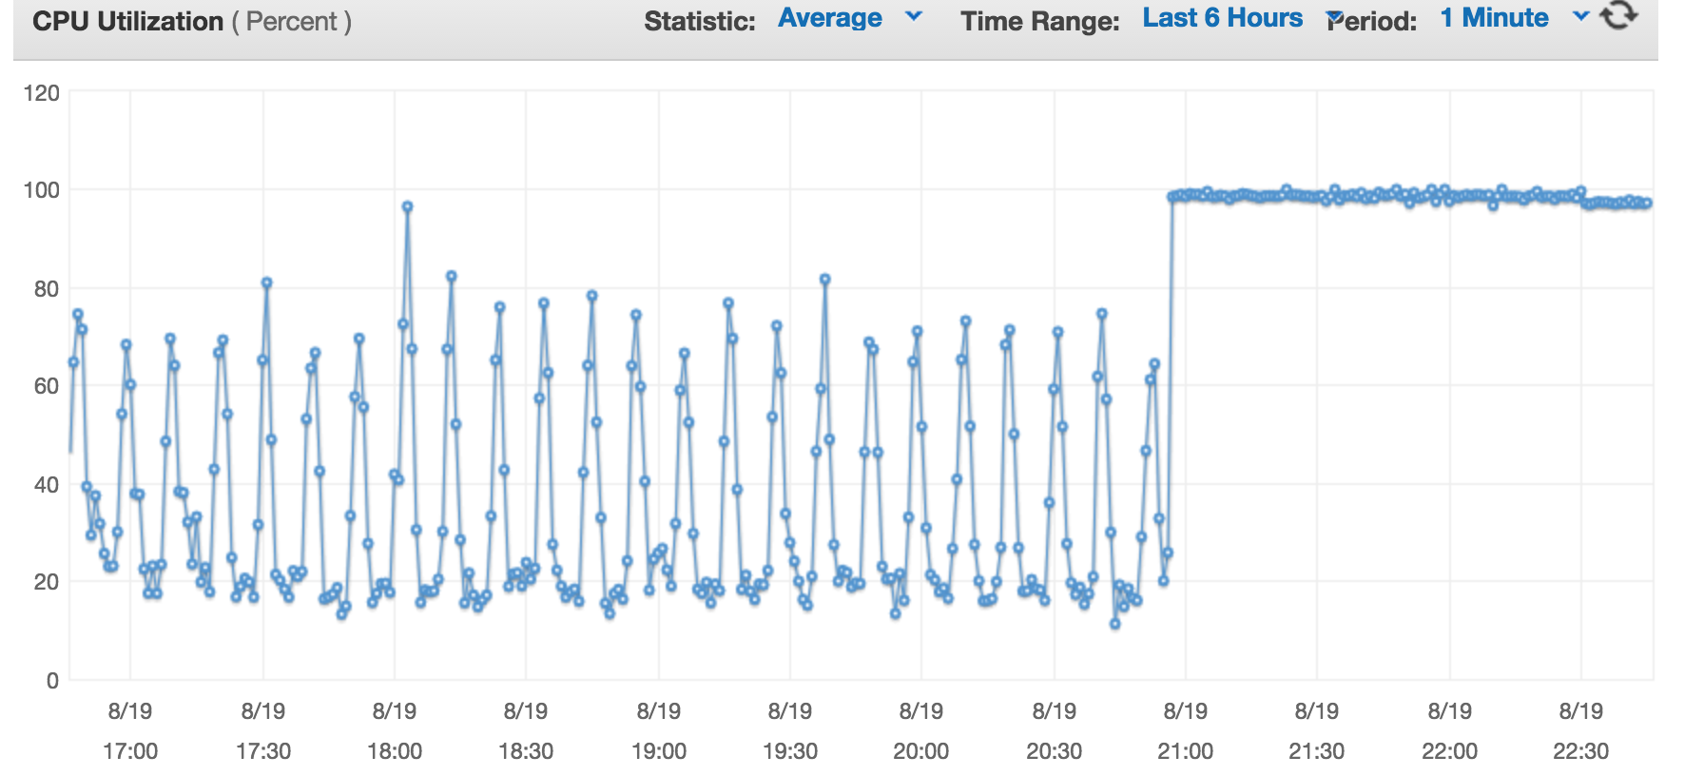
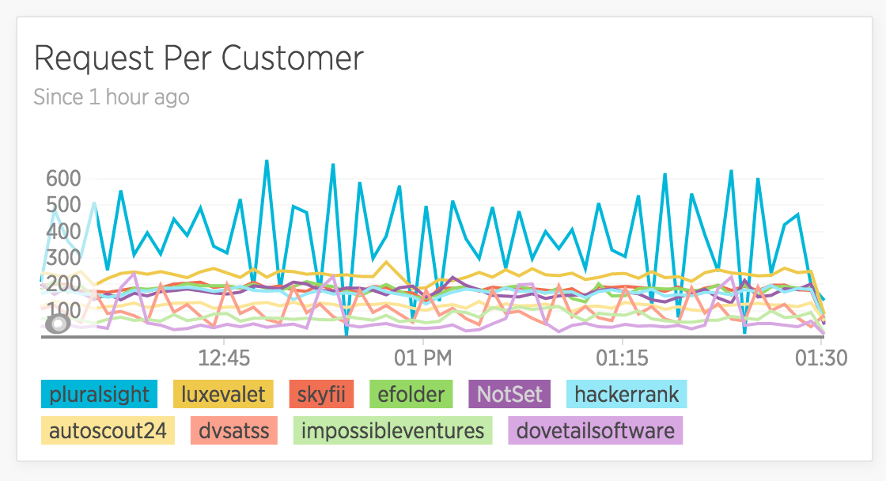
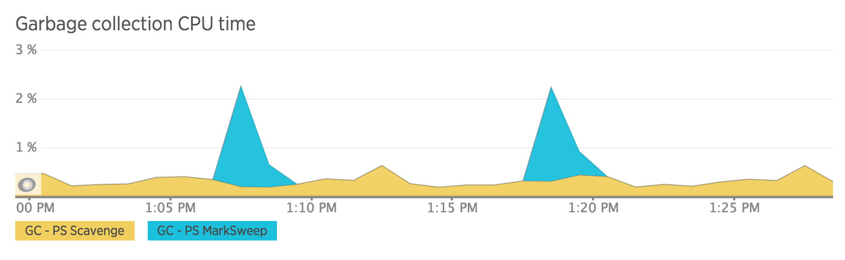
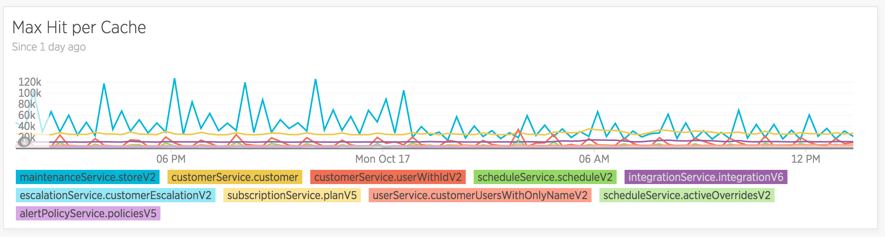
Monitoring

Slide 29
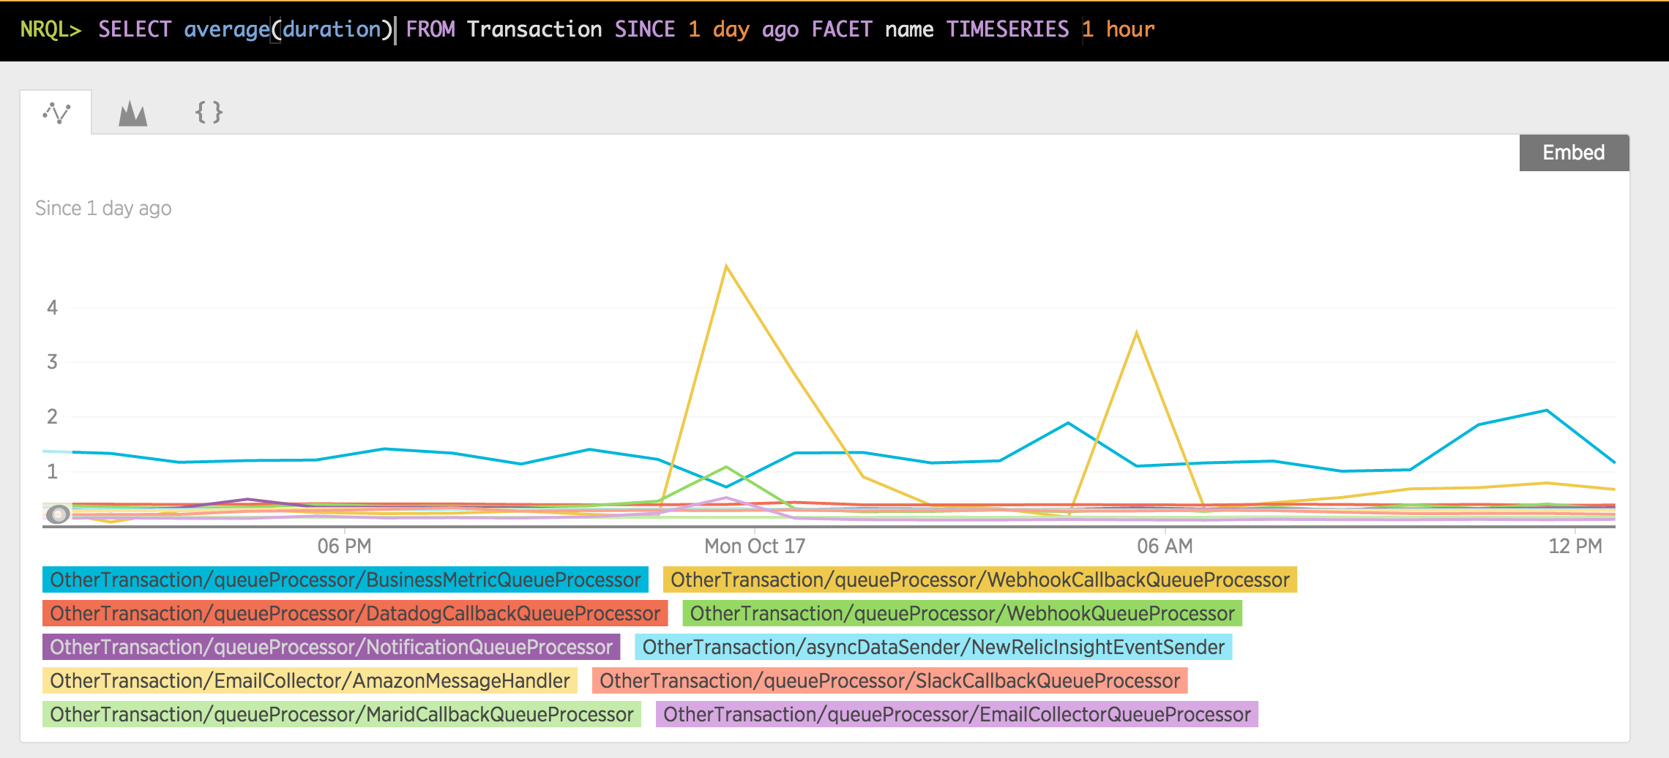
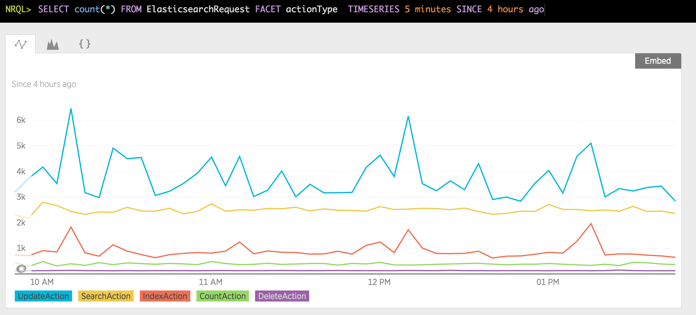
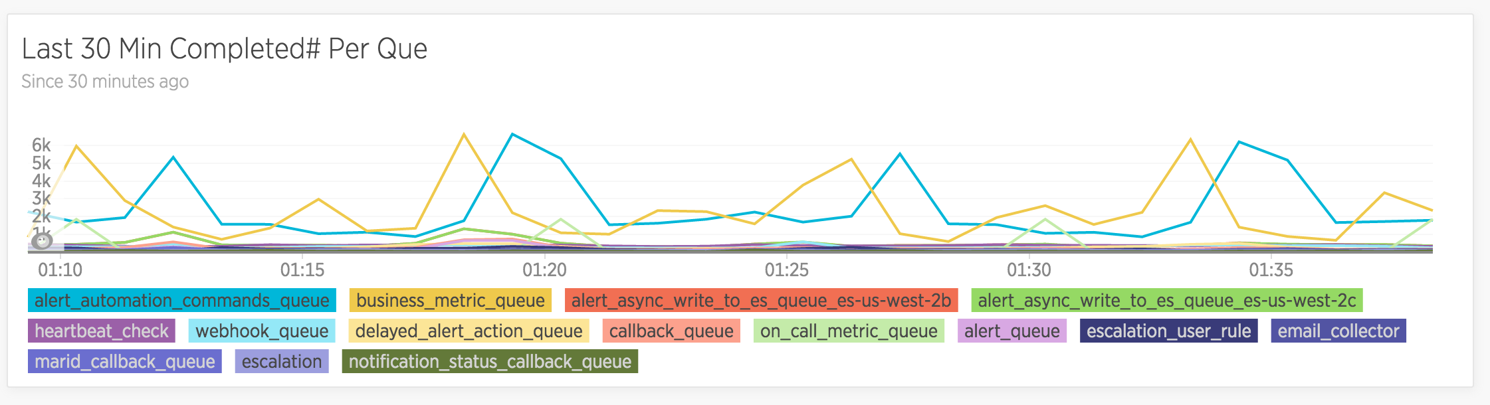
Monitoring

Slide 30
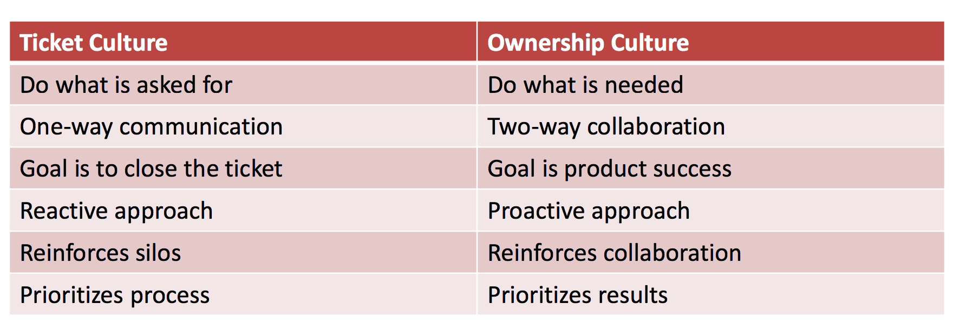
Culture
Transparency
Responsibility
Notes:
Slack channels
Intercom
Iddialar
What is definition of done

Slide 31
Recap
Remember the DevOPS CAMS:
C - Devops is not a job title it’s a culture
It’s all about breaking the barriers between teams in the organization
Lean management - be an owner!
Reward innovation
A - Automate everything
Everything should be automated and versioned even the infrastructure
M - Measure everything
Collect all the data possible regarding the application, business metrics and application metrics alike
Know when something works and when it doesn’t
S - Share
The key to success in a DevOPs environment is sharing knowledge, Share the tools, the process, the results, the code and even failures
Notes:
Slack channels
Intercom
Iddialar
What is definition of done

